Slide 1
Math 210 – Communicating in Math

Slide 2
Group Norms
We will…
Validate each others efforts and contributions
Be patient and listen (really listen) to everyone’s ideas
Say your ideas even if you’re not sure it’s right. Participate!
Be open minded to other people’s ideas.
Not be bossy.
Dr. Keough will…
Be open to suggestions
Not move on too quickly if people don’t understand
Offer guidance but not give things away

Slide 3
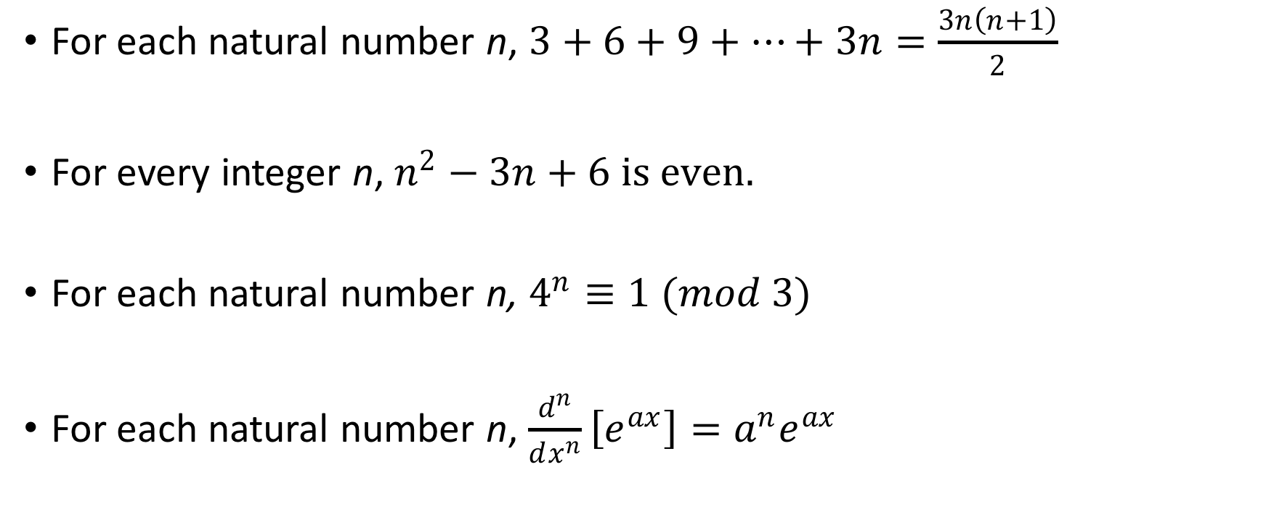
Write down the steps you would do for proof by induction (one of these can’t be done by induction, which one?)
For each natural number n, $3+6+9+…+3n=\frac{3n\left(n+1\right)}{2}$
For every integer n, $n^{2}−3n+6 is even.$
For each natural number n, $4^{n}≡1 (mod 3)$
For each natural number n, $\frac{d^{n}}{dx^{n}}\left[e^{ax}\right]=a^{n}e^{ax}$

Slide 4
Induction Outline
Can we do induction here?
What is P(n)?
What is the base step (P(1))?
Is the base step true?
What is the inductive step (P(k)-> P(k+1))?
Is the inductive step true? (Direct proof of a conditional statement!)

Slide 5
